Slide 1

RETAIL & CONCESSIONS
VISUAL MERCHANDISING GUIDE TO ENHANCE YOUR PROSHOP

Slide 2
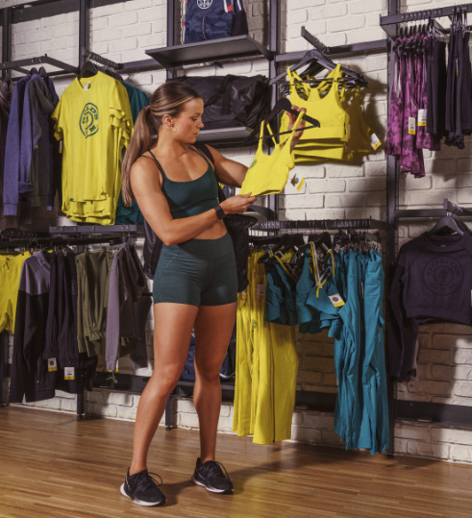
TABLE OF CONTENTS
Create an elevated shopping experience that your consumer can easily navigate through while increasing business KPI’s including units per transaction (UPT) and average transaction dollars (AT). This guide includes details on how to simplify the process of restocking and setting new product. This in turn increases employee productivity and builds brand awareness in a fashion forward way.
Wardrobing Apparel 6
How to organize apparel in your pro shop based on outfitting.
Key Item Impact 14
Highlighting core product to impact revenue.
Color Blocking 17
How to merchandise by color.
.
Accessories & Concessions 23
Tips on organizing items.
Product Detailing 27
How to detail individual products further to enhance the retail experience.
Merchandising Tips 30

Slide 3
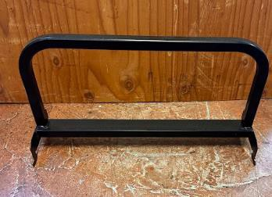
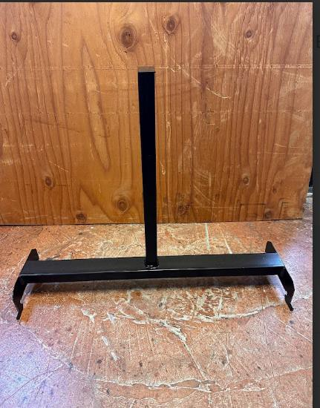
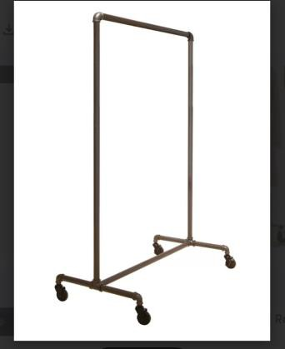
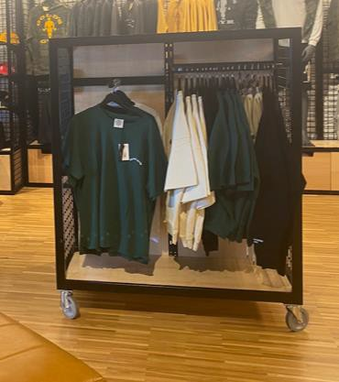
GLOSSARY OF TERMS
SIDE HANG BAR
FACE OUT
ROLLING RACK
GONDOLA

Slide 4
WARDROBING

Slide 5
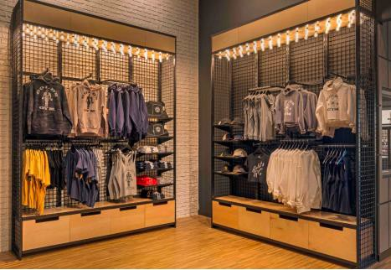
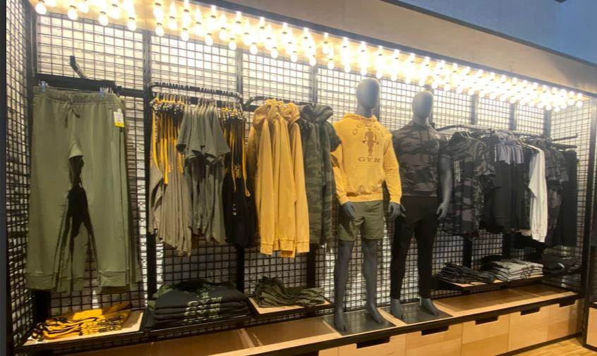
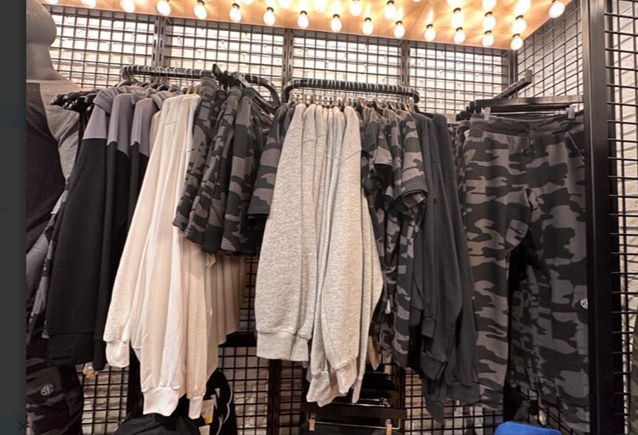
WARDROBING
Wardrobing is the visual merchandising tool to showcase outfit inspiration. Think of wardrobing as picking out an outfit to wear and then displaying it. With any outfit, think of these 3 things to complete the look.
TOP OPTION
Tank, tee shirt or long sleeve
LAYERING OPTION
Jacket or hoodie
BOTTOM OPTION
Pants, shorts or leggings
Wardrobing also helps to drive UPT (units per transaction) and AT (average transaction). This encourages consumers to buy more than 1 item when they see the full outfit. It also creates an easy shopping experience by providing a good consumer service.

Slide 6
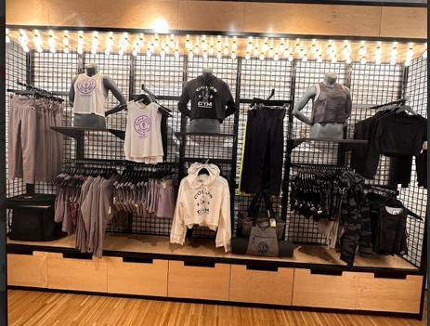
WARDROBING
The goal is to have each piece that is faced out be your higher price point option, also known as your ‘anchor piece.’
Then each ‘face out’ option can be paired with any bottoms shown underneath or hoodies to complete the outfit look.
With strong wardrobing, multiple outfits can be pulled together to entice different style tastes.

Slide 7
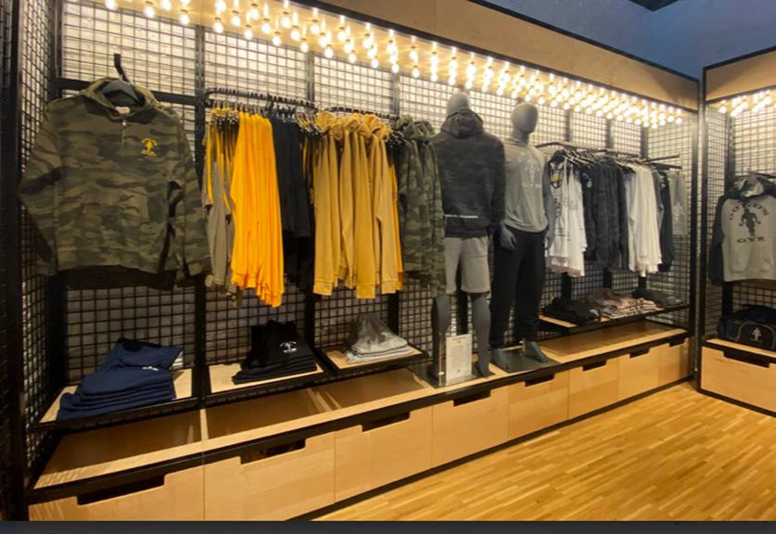
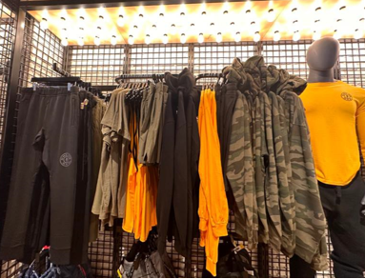
WARDROBING
FIXTURES
Wall Bays
These are the most common and impactful ways to wardrobe. Begin with your most focal or high price point item (your ‘anchor’) faced out. Then hang the other outfit products to the side to complete the outfit. For top over bottom hang system, the same wardrobing rules apply with the top featuring your ‘anchor’ item and bottom row completing the outfit.
‘Anchor’ items should include higher price point items, new pieces, and or stronger colors and feature all sizes.
For women’s bra tops, these can be added to the same rack as the matching bottoms to save space and drive sales as it encourages the consumers to purchase them together.
Side Hang Bar or Rolling Rack
The same format for wall bays can be used repeating the pattern until the rack is full. As an example, hoodies, bra tops, pants, then jacket, tanks, pants.
Shelving
Shelves that are directly below hanging product can feature bottoms to complete the outfit look.
Rolling Racks & Gondolas
These can be used to highlight ‘last chance items,’ sale items or limited gear.

Slide 8
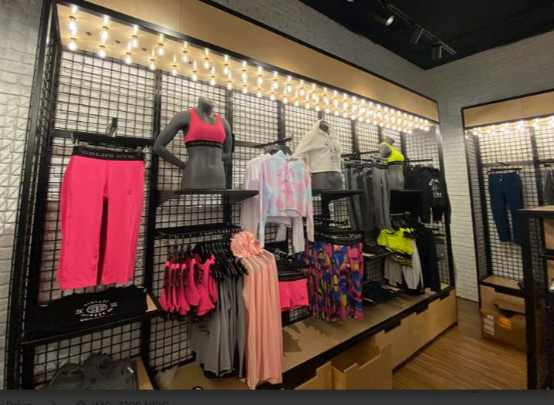
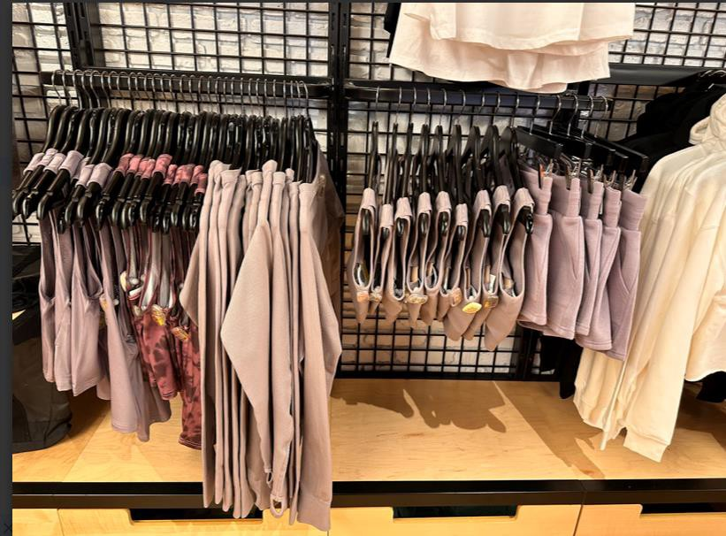
WARDROBING
Example of an entire wall showcasing new products with face outs (anchor pieces).
Example of side hang bars with additional outfit options below anchor items.

Slide 9
KEY ITEM IMPACT

Slide 10
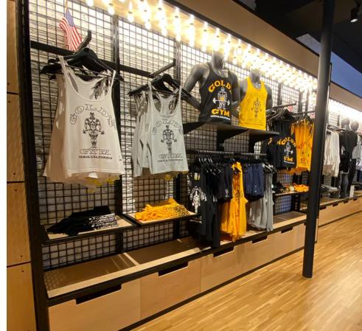

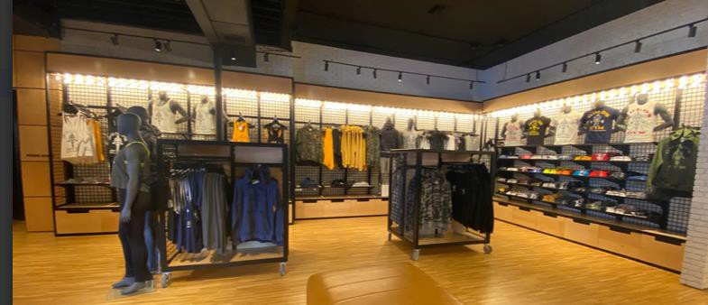
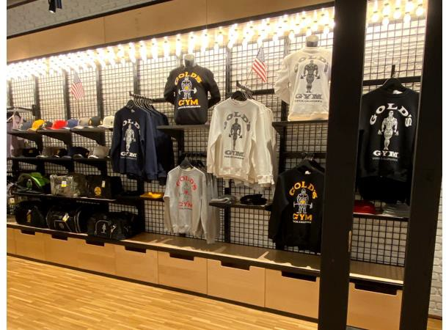
KEY ITEM IMPACT
Grouping and merchandising together in presentation to make an impactful moment and help create ease of navigation for the consumer.
Merchandising items that can be wardrobed within proximity to key impact items can also drive additional sales; hoodie faced out on the wall or bottoms hung folded down near the key impact items.
WARDROBING
KEY IMPACT

Slide 11
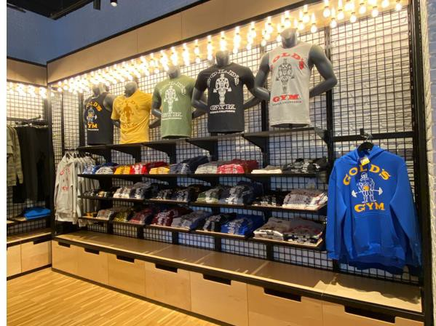
KEY ITEM IMPACT
This alternate strategy can help be used to also drive UPT and AT.
When there are multiple color options of a popular item, merchandising these items together as key impact can help increase sales. Core product would be branded t-shirts, tanks and name drop shirts.

Slide 12
COLOR BLOCKING

Slide 13
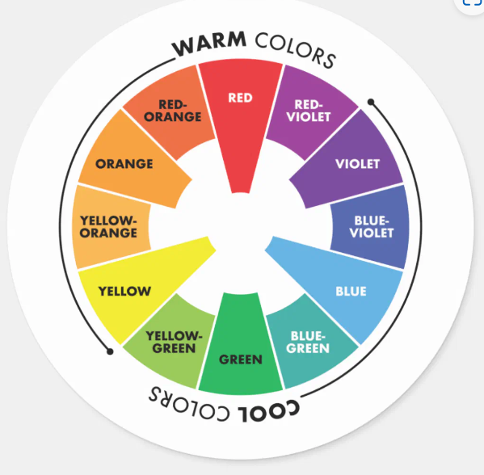
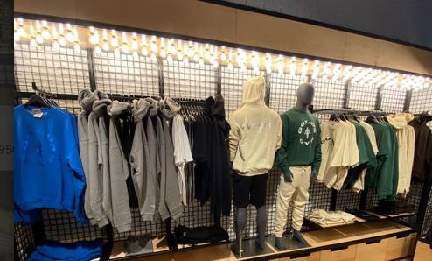
COLOR BLOCKING
When merchandising, group your warm color tones separate from cool color tones, and bridge the two with neutral color tones.
As an example, all warm tones can be hung together, and white or grey tones can be used to break up the display to make the product more visually appealing.
This technique can used on wall bays or gondolas.
WARM COLOR BLOCKING
COOL COLOR BLOCKING

Slide 14
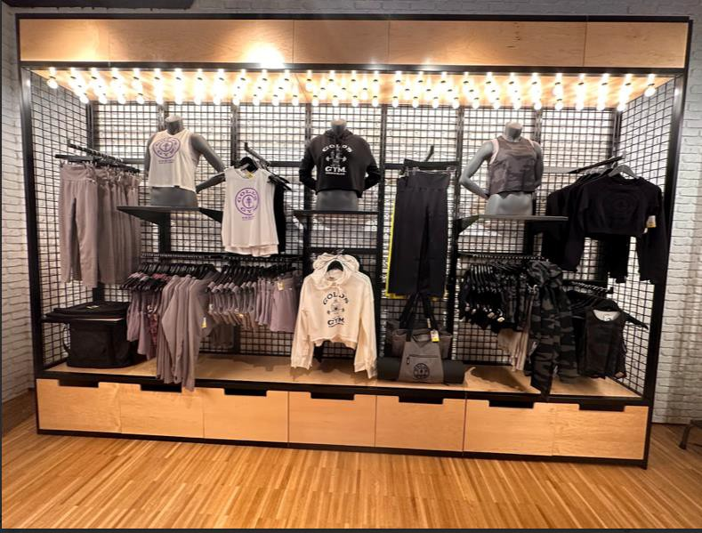
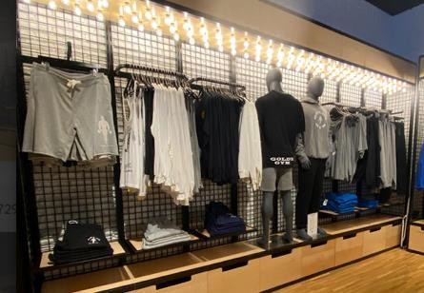
COLOR BLOCKING
NEUTRAL COLOR BLOCKING

Slide 15
ACCESSORIES & CONCESSIONS

Slide 16
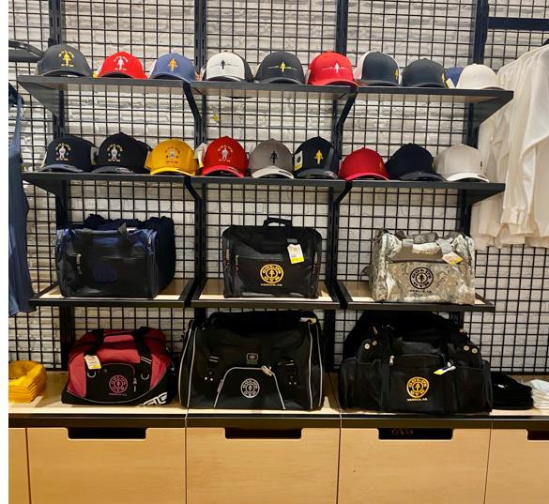
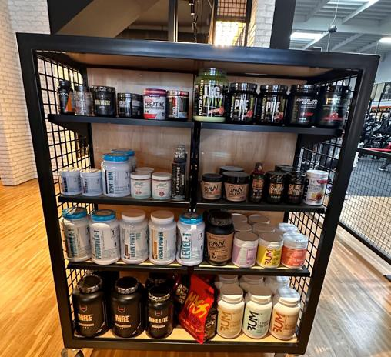
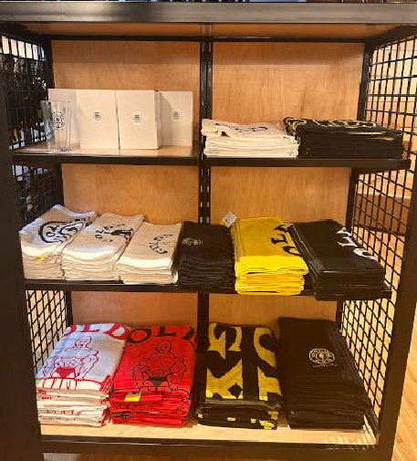
ACCESSORIES & CONCESSIONS
Accessories should be treated as a key item whenever possible as it is statistically proven to drive more business when merchandised together either on an accessory tower, gondola or wall bay.
Concessions and accessories should not be randomly spread throughout your retail space unless it is an item that helps complete the merchandising of another, for instance a hat or bag could be displayed by an outfit.
As a best practice, ensure all items are clearly priced either on the top or bottom of the product.

Slide 17
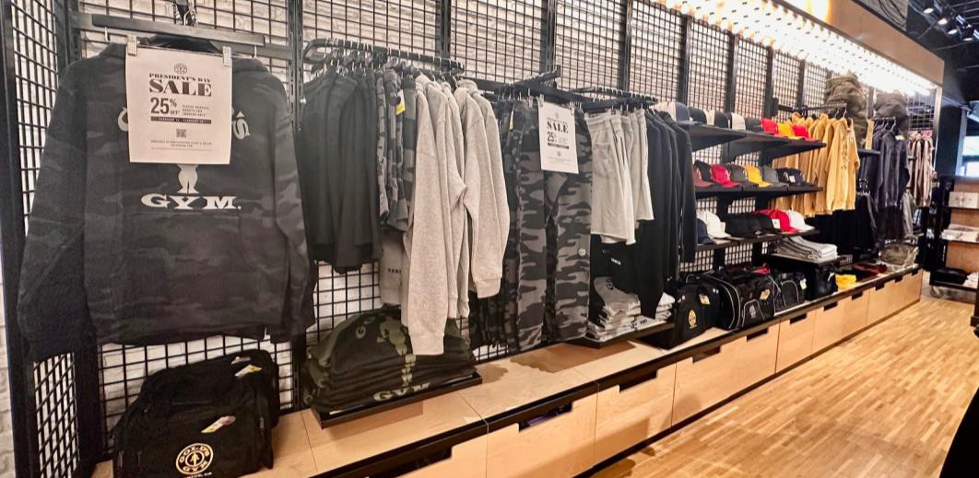
SALE & PROMOTIONAL ITEMS
Sale products can be displayed on wall bays, rolling racks or gondolas with all sizes grouped together to help liquidate remaining inventory quickly. Different price points can be displayed on the same rack.
First time marked down items with a lot of remaining inventory can be grouped together by product versus by size.

Slide 18
PRODUCT
DETAILING

Slide 19
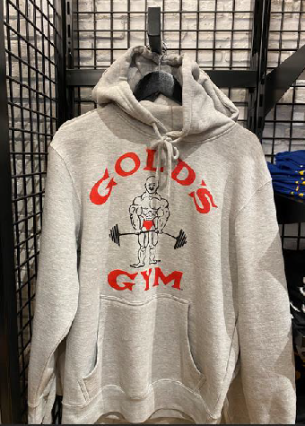
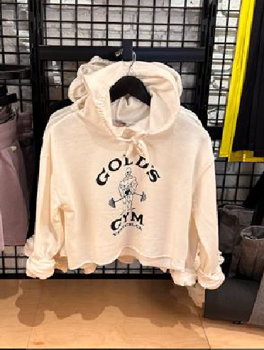
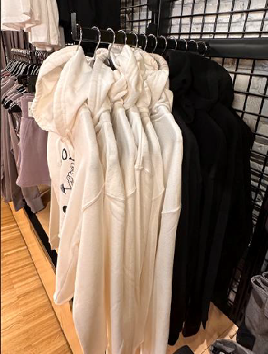
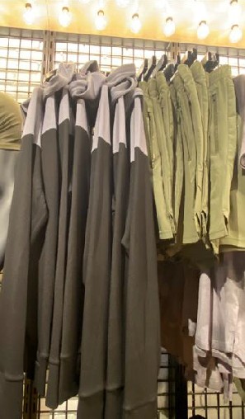
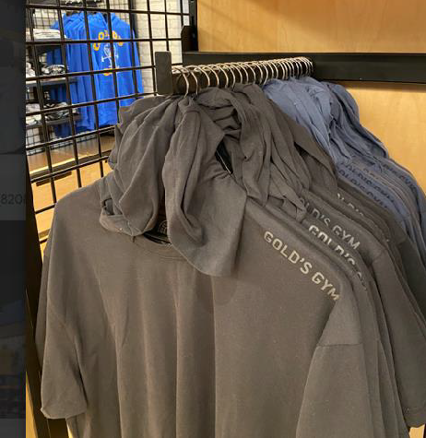
PRODUCT DETAILING
When possible, steam all product before placing on display.
Evenly space all hangers one finger width in-between on face outs and when side-hung.
Roll or cuff long sleeve tops and sweaters.
Pop hoods on outerwear so detail is shown.
Lightly pull the strings on outerwear so it gives the neckline the illusion of being shown on a person.
Tops with longer hems can be knotted on the bottom for the first top that is shown when faced out.
If a bra has a detailed back, hang it backwards to show off the detailing.

Slide 20
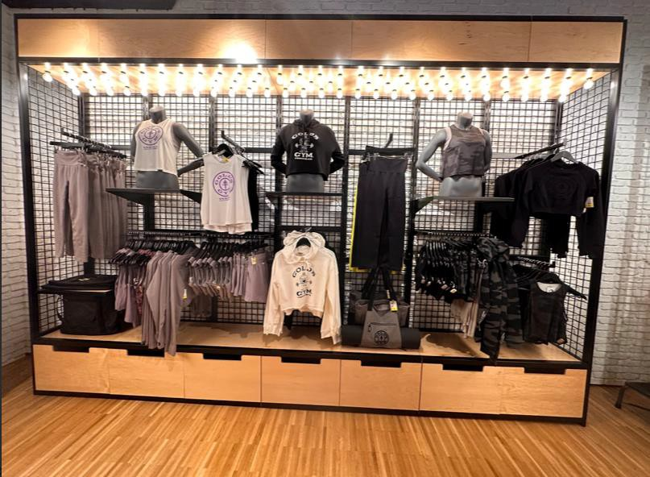
PRODUCT DETAILING
Example of detailing a wall presentation.

Slide 21
MERCHANDISING
TIPS

Slide 22
MERCHANDISING TIPS
When possible, steam all product before placing on display.
Identify the most focal location in your store by standing at the entrance where the consumer checks in and use this when mapping out product placement.
Highlight your highest price point, newest product or key item to drive volume.
Always highlight your top selling items while maintaining inventory.
Changing out product bi-weekly as it sells through is a good way of giving the illusion of new product drops especially for consumers that shop multiple times a week. This includes wall bays and mannequins.
Do not overfill the salesfloor as it can make it a deterrent. Racks should always be finger-spaced and faced out. Stacks of shirts should be 8-10 high, 5-8 for thicker items.
Be sure your hanging retail space is symmetrical as the repetition keeps it clean and simple looking. The easier you make it for the consumer to shop, the more they will. If they have to hunt or product of sizes it minimizes the time they will spend shopping or on other products. Remember, consumers shop the way they read, from left to right. Set the product strategically when wardrobing.
For additional support reach out to your FBC or Erica Berriz at erica.berriz@goldsgym.com

Slide 23
2023 RETAIL & CONCESSIONS

